Slide 1
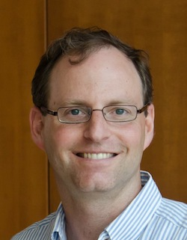
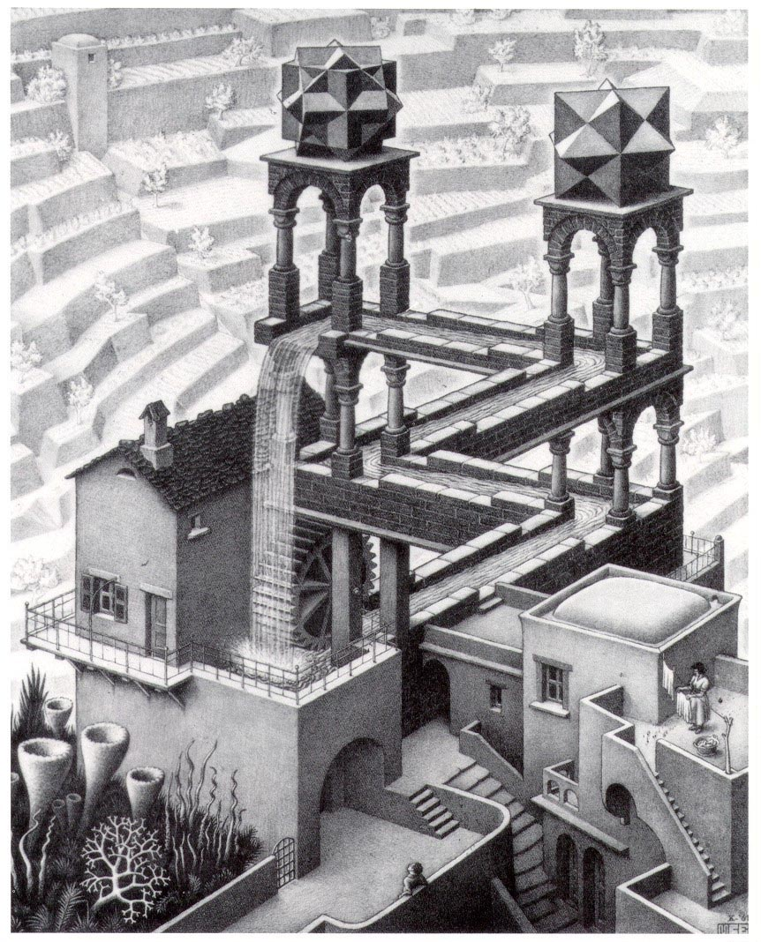
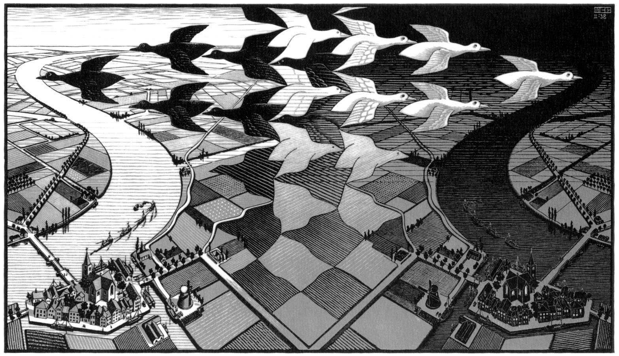
The Sheinberg lab
Seeing. Beyond the image.

Slide 2
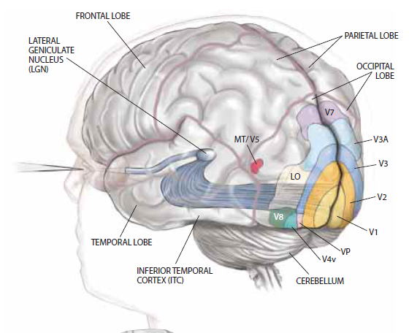
The Sheinberg lab
Seeing. Beyond the image.

Slide 3
The Sheinberg lab
Seeing. Beyond the image.
How does our prior experience shape perception and recognition?
How are attributes of objects linked together to form perceptual wholes?
How does our knowledge about the world shape our perception of the world?
How does information from multiple modalities (e.g. touch and sight) give rise to a unified percept?

Slide 4
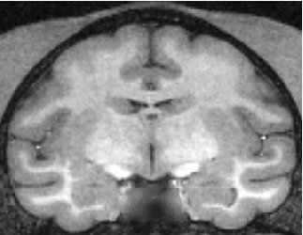
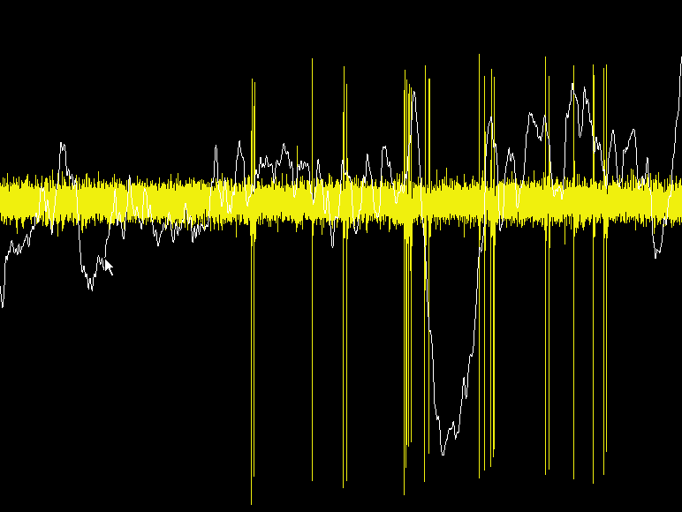
Behavior + Neurophysiology + Computational analysis
Our Approach
Behavior
Neural Activity

Slide 5
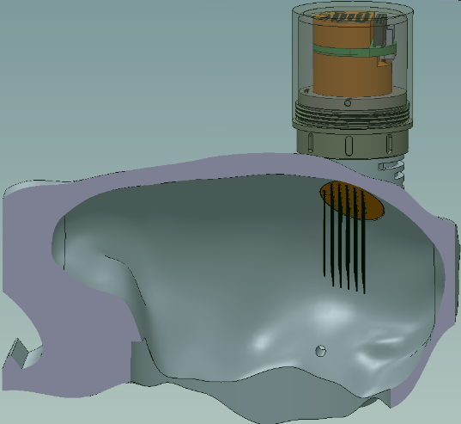
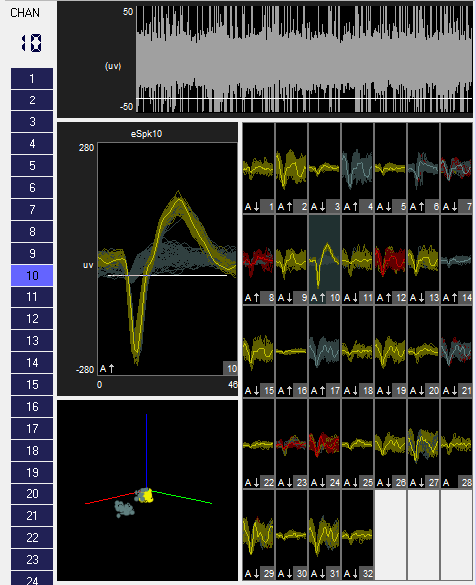
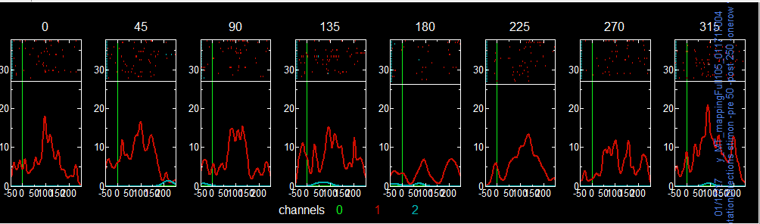
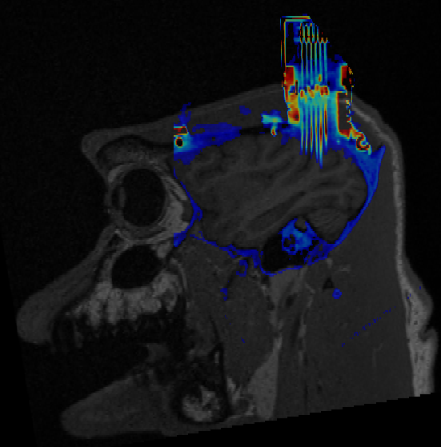
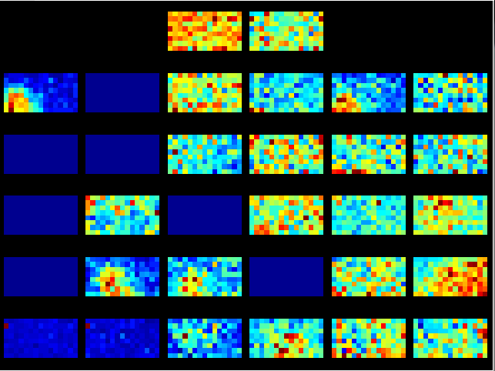
Eavesdropping on many areas

Slide 6
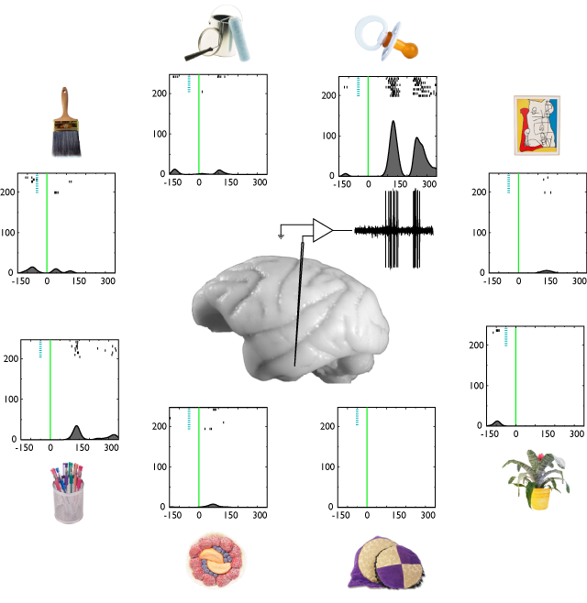
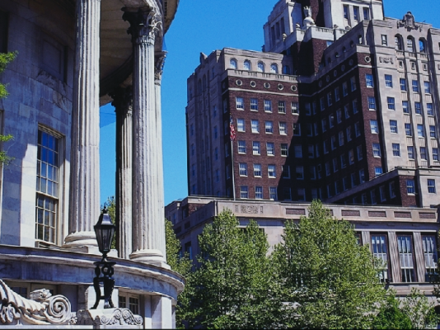
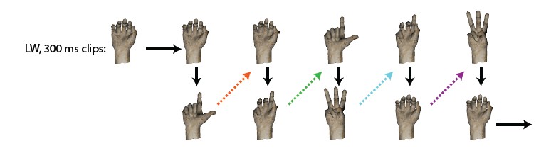
Complex forms, scenes, actions

Slide 7
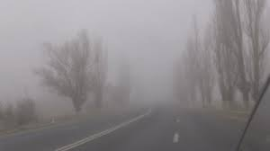
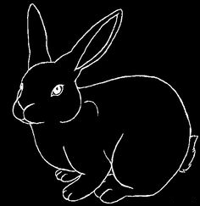
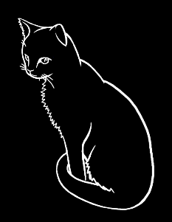
Binding objects and their movements together
or

Slide 8
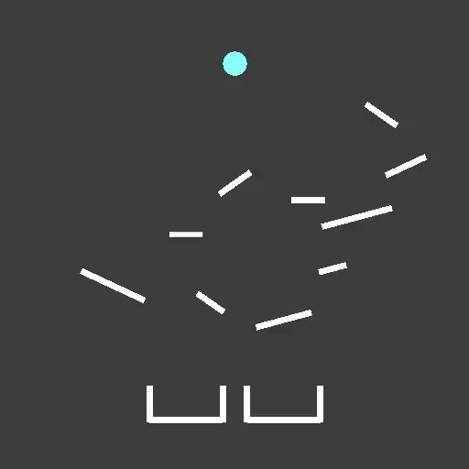
Notes:
A video with an example trial from the task

Slide 9
Cross Species Performance on the Same Task
Human
Monkey
Low uncertainty trajectory
High uncertainty trajectory
Short Trajectory
Long Trajectory
Short Trajectory
Long Trajectory
One session average across multiple human subjects
One monkey average across multiple sessions
Notes:
Bottom line: Even though the monkey’s performance is a little worse than human performance, he is generally comfortably above chance, AND shows similar effects as humans (for example he is unperturbed by increasing simulation length, but is affected by increasing simulation uncertainty).

Slide 10
(Ahuja & Sheinberg, under review)
Notes:
A few methods figures, including the full task outline and the general structure of oculomotor analyses

Slide 11



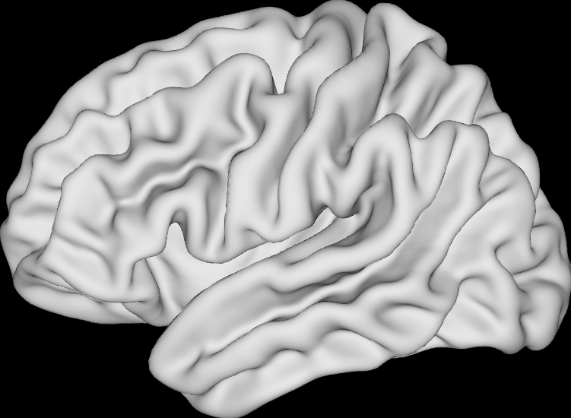
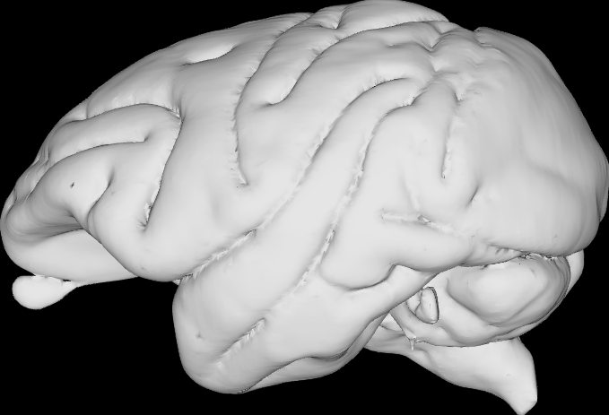
Notes:
Very high level future directions slides

Slide 12
Crossmodal Recognition
If you recognize an object by sight, do you recognize it by touch?

Slide 13
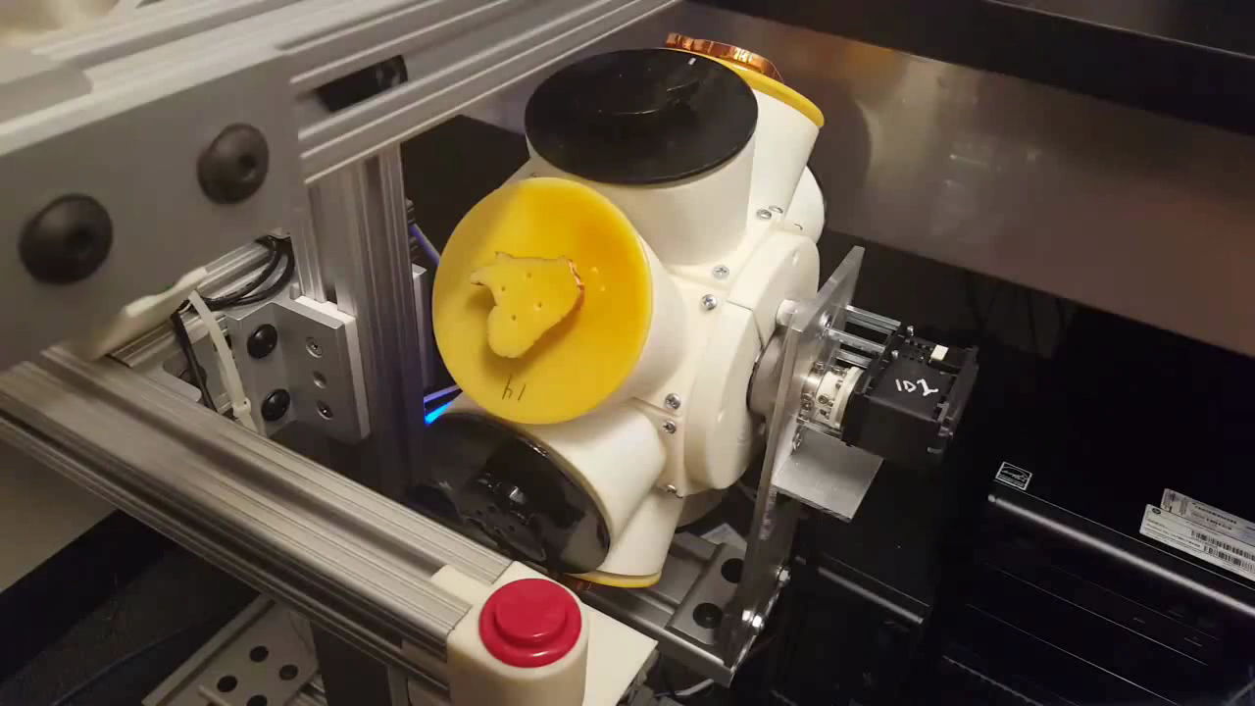
Crossmodal Recognition
If you recognize an object by sight, do you recognize it by touch?

Slide 14
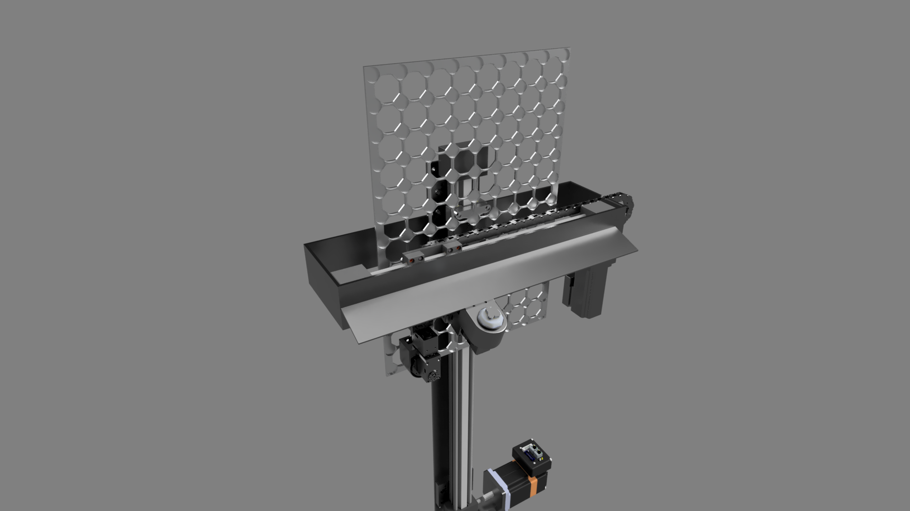
Crossmodal Recognition
If you recognize an object by sight, do you recognize it by touch?

Slide 15
